Slide 1
Basic Mathematics Matrix Algebra

Slide 2
Matrix
A matrix consists of rectangular presentation of symbols and numerical elements arranged in rows and columns.
A matrix is denoted by Capital letter and its elements by corresponding small letters
Number of rows and column in a matrix decides the order of matrix
If a matrix has m rows and n columns then order is given by m*n

Slide 3
General form of matrix
A matrix of the order 2*2 is shown here
Where
A is the name of matrix
a11,a12,a21,a22 are the elements of matrix A

Slide 4
Types of Matrix
Row Matrix
Column Matrix
Rectangular Matrix
Square Matrix
Diagonal Matrix
Scalar Matrix
Identity or Unit Matrix
Null or Zero Matrix
Triangular Matrix

Slide 5
Row Matrix:
A matrix is said to be a row matrix if it has only one row.
A=[1 2 3 ]

Slide 6
Column Matrix:
A matrix is said to be a column matrix if it has only one column.
B=

Slide 7
Rectangular Matrix:
A matrix is said to be rectangular if the number of rows is not equal to the number of columns.
A= 1 2
4 5
7 8

Slide 8
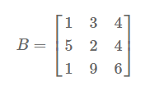
Square Matrix:
A matrix is said to be square if the number of rows is equal to the number of columns.

Slide 9
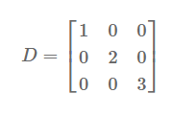
Diagonal Matrix:
A square matrix is said to be diagonal if at least one element of principal diagonal is non-zero and all the other elements are zero.

Slide 10
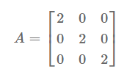
Scalar Matrix:
A diagonal matrix is said to be scalar if all of its diagonal elements are the same.

Slide 11
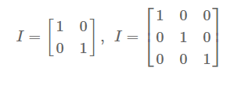
Identity or Unit Matrix:
A diagonal matrix is said to be identity if all of its diagonal elements are equal to one, denoted by I.

Slide 12
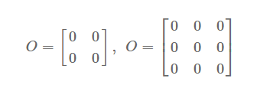
Null or Zero Matrix:
A matrix is said to be a null or zero matrix if all of its elements are equal to zero.
It is denoted by O.

Slide 13
Triangular Matrix:
A square matrix is said to be triangular if all of its elements above the principal diagonal are zero (lower triangular matrix) or all of its elements below the principal diagonal are zero (upper triangular matrix).

Slide 14
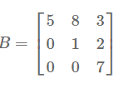
Upper Triangular Matrix

